Slide 1
Political Savvy
John M. Robinson (SES Retired)
Former Director of the Office of Civil Rights and Chief Diversity Officer
U.S. Department of State
June 8, 2017

Slide 2
Agenda
Office Politics vs. Political Savvy
Political Savvy Competencies
How Politically Savvy Are You?
Strategies for Developing Political Savvy
Questions

Slide 3
Leadership Competencies Aligned to the ECQs
Leading Change | Leading People | Results Driven | Business Acumen | Building Coalitions
Creativity & Innovation | Conflict Management | Accountability | Financial Management | Partnering
External Awareness | Leveraging Diversity | Customer Service | Human Capital Management | Political Savvy
Flexibility | Developing Others | Decisiveness | Technology Management | Influencing/ Negotiating
Resilience | Team Building | Entrepreneurship
Strategic Thinking |  | Problem Solving
Vision |  | Technical Credibility
6 Fundamental Competencies
Interpersonal Skills | Oral Communication | Continual Learning
Written Communication | Integrity/Honesty | Public Service Motivation
Notes:
22 competencies aligned to the ECQs
6 fundamental competencies that serve as foundation for each of the ECQs

Slide 4
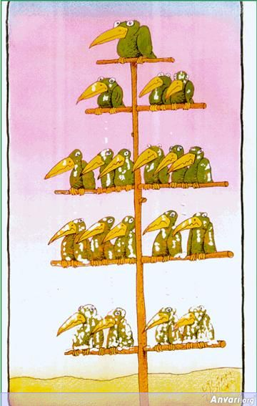

Office Politics vs. Political Savvy
Office Politics
Political Savvy

Slide 5
Office Politics (or Office Culture)
Perceived as a self-serving way to promote personal interests – often at the expense of others (win-lose)
Persons who adopt this definition of office politics may prefer not to “play the game” but may fear their careers will suffer if they don’t

Slide 6
Office Politics (or Office Culture)
How power, influence, and interests play out in an organization
Office culture is “simply the way things really get done around here”

Slide 7

WARNING!!
Be aware of your own political style, which generally is developed from a set of experiences early in one’s career
Political blind spot – not consciously seeing the extent to which informal influence shapes the decision making process
  Limelight leadership vs. behind the scenes leadership

Slide 8
Political Savvy
Understands and utilizes the dynamics of power, organization, and decision making to achieve win-win objectives
  Political savvy managers view workplace politics as neutral (not good, not bad); it’s simply a natural part of life in virtually all organizations
Involves the sincere use of your skills, behaviors, and qualities to be more effective
  It’s not about being false and inauthentic

Slide 9
Political Savvy Is …
The totality of your skills for successfully navigating the political dynamics of an organization to accomplish one’s goals
Using ethical strategies, cultivating relationships and establishing your brand as a professional, team player and leader
The ability to exhibit confidence and professional diplomacy, while effectively relating to people at all levels internally and externally. DHHS/National Institutes of Health

Slide 10

Center for Creative Leadership (CCL) Research
Those who are politically savvy have better career prospects and career trajectories
  Seen as more promotable and less likely to have derailed careers

Slide 11
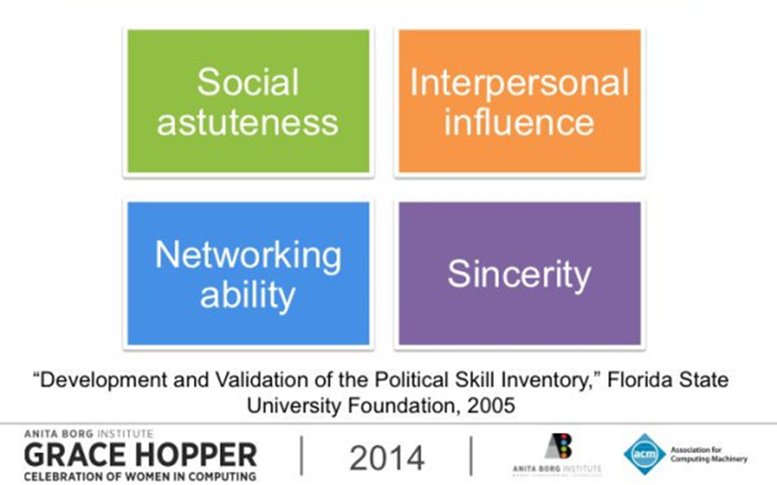
4 Competencies of Positive Political Savvy

Slide 12
CCL: Political Savvy Requisite Competencies
Competencies Skills | Thinking Before Speaking (Social Astuteness) | Inter-personal Influence | Net-working Ability | Sincerity
Building Collaborative Relationships | X | X |  | X
Composure | X |  |  | X
Putting People at Ease |  | X |  | X
Career Management | X |  | X | X
http://insights.ccl.org/wp-content/uploads/2015/04/WomenPoliticalSavvy.pdf

Slide 13
Social Astuteness
Thinks before speaking
  Able to size up situations well before speaking
  Considers potential impact of their words on others
  Most significant career derailment predictor is a low rating on this
Maintains composure
  Calm in a crisis
  Recovers quickly from mistakes
  Controlling impulses during difficult times
  Being responsible for what you say

Slide 14
Interpersonal Influence
A subtle and convincing personal style
Able to put people at ease
  Warm, good sense of humor
  People comfortable in your presence
Able to adapt their behavior according to their audience
  Translates into especially strong relationships with their bosses (can “manage-up” well)

Slide 15
Networking Ability
Adept at managing one’s own career
  Develop, maintain and use professional relationships for mentoring, coaching and feedback
  This skill has one of the largest numbers of meaningful correlations with political savvy
Adept at developing and using diverse networks

Slide 16
Sincerity
Being sincere is at the foundation of political savvy, which is not about being false or inauthentic
Reminder: political savvy is about understanding how to use your skills, behaviors and qualities to be effective
AND SINCERITY IS VITAL TO THIS!!!

Slide 17
Political Savvy: Key Behaviors
Understands the process of how decisions are made
Identifies the key decision-makers and the people who influence them
Identifies ways to increase visibility and influence by participation in formal and informal activities
Understands the interests, motivations, and agendas of others

Slide 18
Political Savvy: Key Behaviors
Promotes the interests of other key decision makers and influencers in order to obtain support for one's own agenda
Understands the roles people play in an organization and uses that understanding to achieve objectives
Establishes alliances with people of power and influence in order to influence decisions and outcomes
Accurately anticipates changes in the political climate and plans and executes strategy and tactics based on that anticipation

Slide 19
Political Savvy: Key Behaviors
Puts the organization first
Plays above board
Practices openness and involves others
Able to accept and work with persons who hold different values to their own

Slide 20

Political Savvy
Looks for the Win-Win
vs Compromise: parties often remember what they gave up (lost) more than what they gained

Slide 21
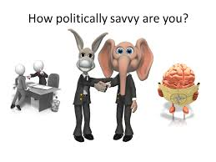

Slide 22
True or False?
One sometimes has to manipulate the situation to get results.
FALSE – most politically savvy people avoid manipulation, as it is often associated with unethical behavior
The Savvy make sure they stay above board and use ethical influence and avoid manipulating the situation or other people.

Slide 23
True or False?
Dealing with my organization’s politics is a necessary evil.
FALSE – most Savvy people look for the win-wins in the situation, which acts as a source of zest and positive sense of contribution, not just a necessary evil.

Slide 24
True or False?
Those politically savvy generally have higher interpersonal skills.
FALSE – those seen as Savvy by their colleagues didn’t score significantly higher on interpersonal skill measures than non-savvy. The difference was more in their strategic mindset and the basic Savvy strategies.

Slide 25
True or False?
Those politically savvy are often more likely to work alone.
FALSE – The Savvy know they need to build coalitions to make an impact.

Slide 26
True or False?
Those politically savvy generally care a lot about ideas.
TRUE - Ideas allow the Savvy to be about something larger than themselves.
Working with ideas for the greater good of the business allows them to play above-board with others.

Slide 27
True or False?
Those politically savvy are as likely to take credit as give it.
FALSE – most Savvy give far more credit than they receive and they are expert at honestly giving credit for effort a great deal of the time while still make decisions based upon performance.
Credit giving is one of the key distinctions between the Savvy and credit stealing done by those who put their own self interest first.

Slide 28
True or False?
Those politically savvy often take significant risks to attain important goals.
FALSE – The Savvy generally do not take significant risks; they are excellent at managing risk down as are effective entrepreneurs.
This ability allows them to take many more smart risks than others, which increases the odds of having significantly more successful influence attempts than those who avoid risk.

Slide 29
True or False?
Those politically savvy invest a great deal in making decisions more rational.
TRUE - The Savvy use more of a human nature approach which assumes people are partly but not entirely rational; thus, the Savvy work hard to ensure that dysfunctional politics are NOT what drives decisions.
The Savvy often create more rational organization decisions than the smart, rational but unsavvy group.

Slide 30
True or False?
Those politically savvy are willing to confront those they know are acting purely out of self-interest.
FALSE – Confronting a skilled self-interested unsavvy person often backfires and you are made to look jealous or foolish.
Allowing the self interested to catch themselves using a variety of methods is likely a more effective approach.

Slide 31

How Did You Do?
1-3: generally represents a mindset; one that is traditionally hierarchical, command and control in nature, and believes in being completely straightforward.
4-5 (most common score): traditional view of political savvy that is less black and white than above.
  Persons in this level generally work within the traditional views of hierarchical organizations, but also recognize that the human dimension plays a significant role.

Slide 32
How Did You Do?
6-7: Those likely to be conscious of both the informal and formal organization, which allows them greater odds of effectively using both formal and informal influence approaches.
  Consequently, they are likely to be more successful at getting things accomplished.
8-9: Those who are a natural at being politically savvy and have intuitively attained a high degree of integration of human nature and hierarchical expectations within an ethical framework.
  Congratulations! Only about one in 20 achieve this level!

Slide 33
Strategies for Developing
Political Savvy
Network – connect with influential people; observe how they behave and carry themselves in meetings
  Caution: Don’t get sidetracked; continue to develop and manage your direct reports
Find a mentor who can help educate you on what drives your agency
  Carefully consider how the relationship will benefit both you and your mentor
Scan your environment – pay attention to posture, non-verbal cues; consider what is driving others and how they advance their position
  Understand what drives your agency and your boss

Slide 34


General Policy Development
President’s and/or
Agency Head’s Priorities
Understand what shapes your agency’s policy decisions
Stakeholder Views
(e.g., Congress, State/Local Govts, Industry, Community and/or Public Interest Groups)
Timing
Policy
Decision
Economic Analyses
Legal Authority
Executive Orders, Department directives, etc.
Budget
[Sound scientific basis
if science based agency]

Slide 35
Strategies for Developing
Political Savvy
Think before you act – explore alternatives and the responses each will evoke
  Do you have “hot buttons” people can easily push? Develop more effective ways to respond.
Inspire trust – align your actions, tone, gestures, and words
  Pay attention to your nonverbal behavior (lack of eye contact; checking phone during meetings)
  Ask for feedback
  Keep confidences and avoid gossiping – no exceptions!

Slide 36
Strategies for Developing
Political Savvy
Read the newspapers, books and other publications with comprehensive political analyses to learn/understand opposing viewpoints on particular issues.
Read trade magazines covering your agency and your agency’s website’s highlights each morning when you log in.
Listen/watch radio/TV programs that cover political issues (e.g., watch CSPAN when your agency testifies before Congress; budget hearings).

Slide 37
Strategies for Developing
Political Savvy
Know the names – and faces – of your agency’s senior leaders.
  Have your 15 second and one-minute “speech” ready for “the elevator meeting”
Be a team player, supportive of others, share the credit

Slide 38
Strategies for Developing
Political Savvy
Speak with people in your organization who understand the internal and external politics that affect the agency.
Participate in a Legislative Fellowship Program or a statewide leadership team meeting in some role (e.g., scribe or facilitator).
Do a detail in the Washington Office or state office External Affairs.
Serve on an agency nationwide policy group, interagency group, or a community outreach program.

Slide 39
Strategies for Developing
Political Savvy
Learn how to manage conflict well
  Get a coach if you need to improve your skills
  Don’t overcorrect by avoiding all conflict or constantly trying to smooth things over
Distinguish between interests and positions to find win-win outcomes

Slide 40
Key Differences
Position
Interest
Focuses on a particular solution
Makes a demand
Sets up confrontation before issue is clearly defined
Designed for anticipated bargaining; compromise
Focuses on the problem
States one of a range of needs
Establishes a climate & common language for discussion so real issue can be understood and discussed

Slide 41
References
https://www.govloop.com/community/blog/political-savvy-average-employee/
DHHS Executive Leadership Competencies – Political Savvy
http://hhsu.learning.hhs.gov/competencies/leadership-political_savvy.asp
Center for Creative Leadership, “Women and Political Savvy” (Sept. 2012)
http://insights.ccl.org/wp-content/uploads/2015/04/WomenPoliticalSavvy.pdf
Political Savvy IQ Quiz and Responses
http://www.organizationalpolitics.org/docs/results.asp
Political Savvy: Systematic Approaches to Leadership Behind the Scenes – Joel R. DeLuca, Ph.D.
“Leadership Excellence – Building Coalitions & Communications: Political Savvy”
http://www.au.af.mil/au/awc/leadership/blm/27_main_building_political.htm

Slide 42


